Slide 1




Whitby
Official Plan Review
Statutory Public Meeting OPA 146 and 147
October 1, 2025

Slide 2
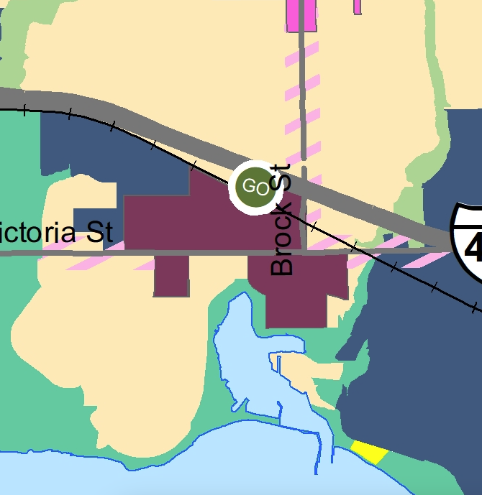
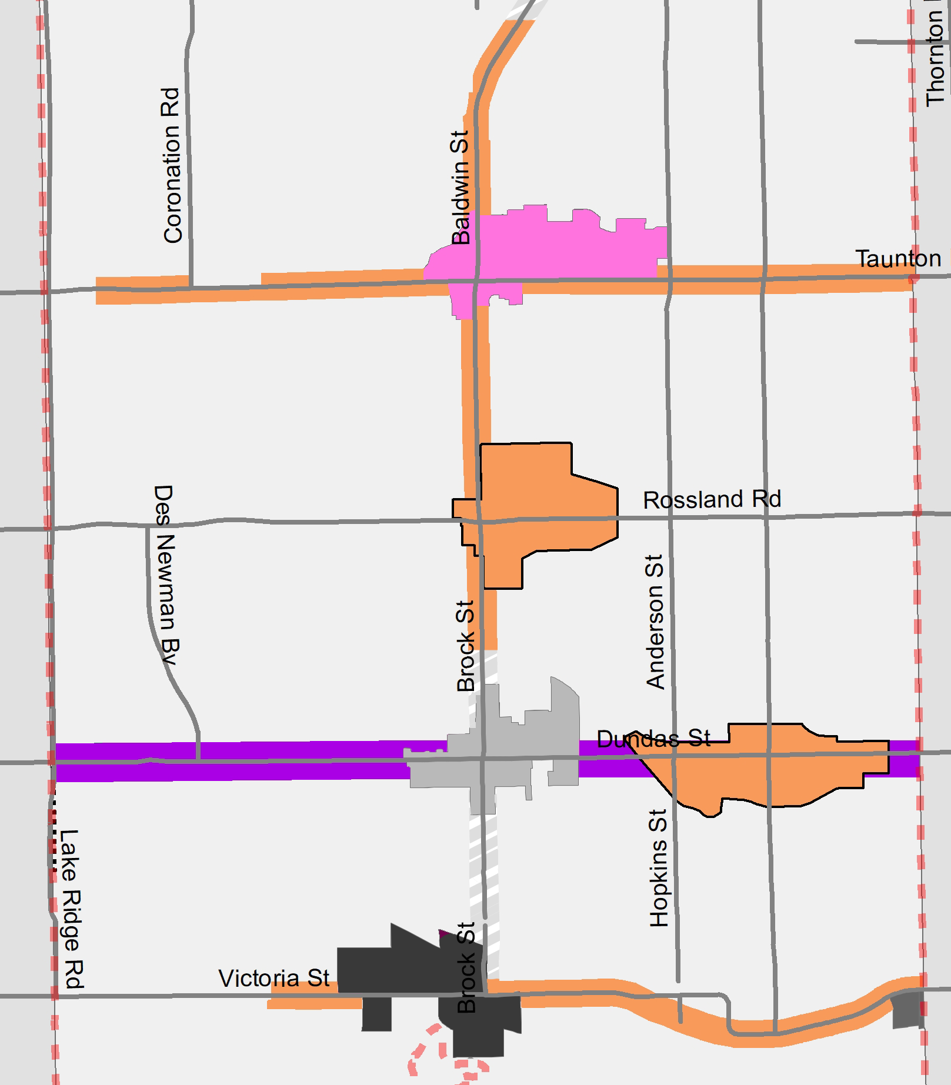
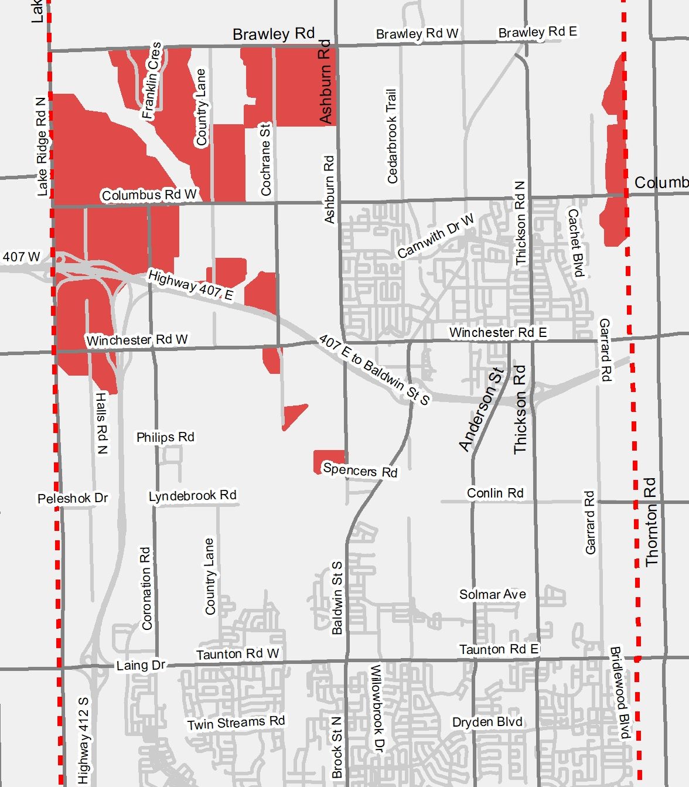








Focus Area 1
Focus Area 2
Focus Area 3
Focus Area 4
Whitby GO Protected Major Transit Station Area (PMTSA)
OPA 138
Other Strategic Growth Areas and Nodes and Corridors
OPA 139
Brooklin Urban Expansion Area per Envision Durham
OPA 148
General Updates to the Official Plan to prepare for growth to 2051
OPAs 146 & 147
PMTSA

Slide 3
OPA 146 Key Changes - Overview
  Updated policies to conform to Provincial legislation including 2024 PPS.
  Incorporated relevant policies from Envision Durham, as it relates to Whitby, and rescind Envision Durham.
  Streamlined Growth Management policies on Intensification Areas and Strategic Growth Areas.
  Streamlined Commercial and Mixed Use policies.
  Increased flexibility where appropriate.
  Streamline and clarified policies and removed outdated policies.
  General housekeeping changes.
  Green text is text that has been moved internally in the OP.
  Orange text is text adopted in OPA 138 or 139.

Slide 4
OPA 146 Key Changes - Growth Management
  Updated Urban Area Boundary to reflect to 2051 boundary as per Envision Durham
    In Brooklin and West Whitby.
  Updated population and job forecasts to 2051.
  Deleted reference to “Built Boundary”.
  Combined Major Central Area and Intensification Areas/Corridors into one single category called Strategic Growth Areas (SGAs) including:
    Protected Major Transit Station Areas (PMTSA)
    Major Central Areas
    Community Central Areas
    Rapid Transit Intensification Corridor
    Intensification Corridors.
  Local Central Area symbols replaced with underlying Neighbourhood Commercial designation.

Slide 5
OPA 146 Key Changes - Residential
  Permit Townhouses in the Low Density Residential designation, provided maximum density is not exceeded.
  Removed max density cap in the High Density Residential (HDR) designation.
    controlled by height and function of built form.
  Redevelopment and Intensification policies (4.3.3.8) moved to Growth Management (4.2.3.7).
  Mature Neighbourhoods policies (4.3.3.12) moved to Growth Management (4.2.3.8).

Slide 6
OPA 146 Key Changes – Commercial and Mixed Use
  Streamlined into 5 designations:
    Main Street Mixed-Use
    Residential Mixed-Use
    Major Commercial Mixed-Use
    Community Commercial Mixed-Use
    Neighbourhood Commercial.
  Require existing non-residential floorspace be retained through redevelopment.
  Require a minimum floor space for non-residential in the Residential Mixed Use.
  Local Commercial and Convenience Commercial combined into one designation – Neighbourhood Commercial.
  Introduced a Special Mixed Use designation for Lynde Shores Nordeagle site.
  Removed Special Purpose Commercial Designation – changed to Business or Community Commercial Mixed use.

Slide 7
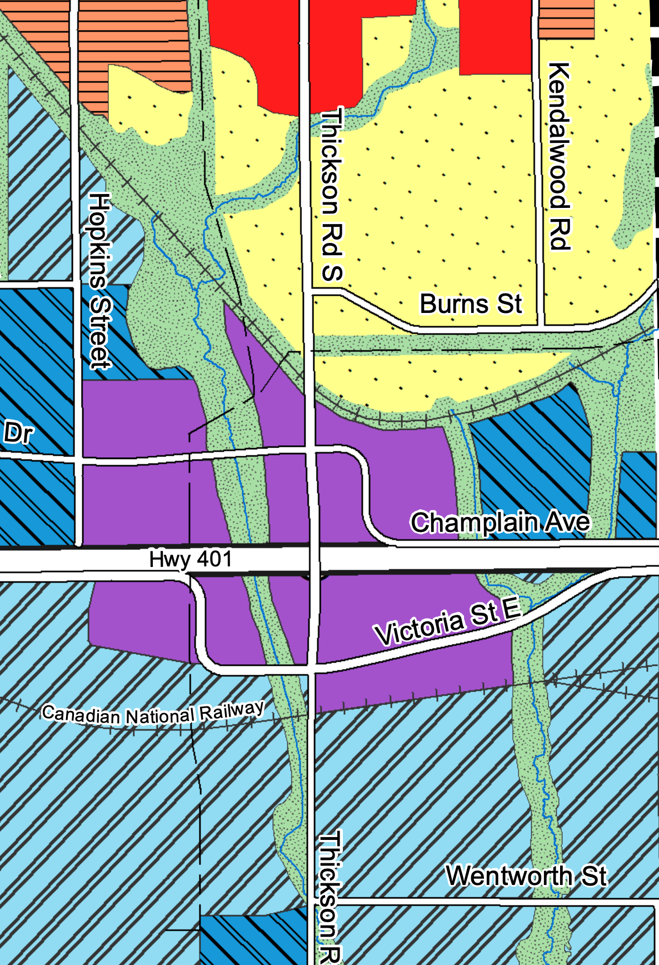
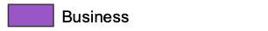
OPA 146 Key Changes - Employment
  Renamed General Industrial to Industrial Employment.
  Renamed Prestige Industrial to Prestige Employment.
  Removed certain uses in Prestige Employment designation.
  Created a new Business designation for uses no longer permitted in Employment Areas includes:
    A number of Special Purpose Commercial sites,
    Special Activity Node B,
    A number of Prestige Industrial sites.
  Policies on conversion updated to be consistent with PPS.

Slide 8
OPA 146 Key Changes – Major Open Space
  Updated park classification hierarchy:
    Removed parkland rate per 1,000 population, as covered by legislation,
    Revised sizes of each park classification,
    Updated uses.
  New classifications for:
    Parkettes,
    Urban Parkettes,
    Sports Field Parks.
  Updated parkland dedication policy to reflect changes to Planning Act.

Slide 9
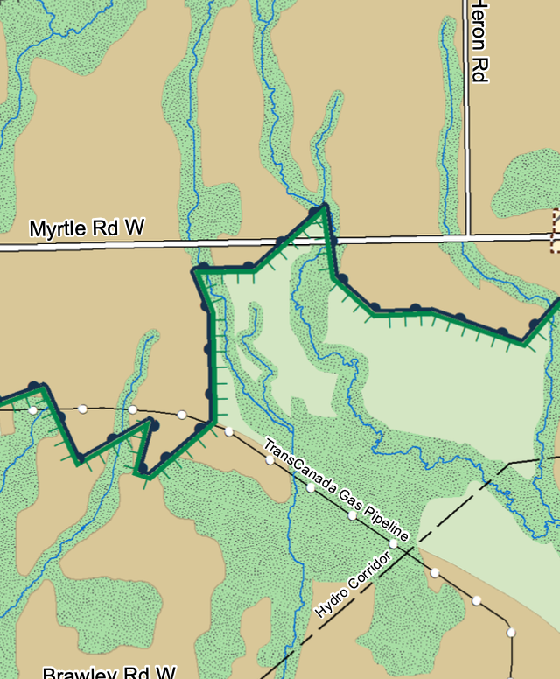

OPA 146 Key Changes – Agriculture / Rural
  Updated agricultural related and on-farm diversified land use policies.
  Introduced a new Rural Area designation.
  Rural designation permits in addition to uses in Agricultural Area designation:
    Recreation,
    Tourism,
    Small scale agriculture-related institutional, commercial and industrial uses.

Slide 10
OPA 146 Key Changes – Section 5 Environmental Management
  Policy added to support restoration and enhancement initiatives as part of development applications.
  Policy added for Town to consider compensation for removal of isolated non-significant natural features.
  Added policy section on Drinking Water Source Protection.
  Added policy on designated Class 4 Areas to address noise.
  Added policy section on Environmental Stewardship.
  Moved Stormwater Management policies (5.3.10) to Section 8 Transportation and Servicing (8.2.5).

Slide 11
OPA 146 Key Changes – Section 6 Community Development
  Updated cultural heritage resource policies to streamline redundant/repetitive policies.
  Updated policies related to archaeology and Indigenous engagement.
  Add policies on adaptive re-use of heritage properties.
  Updated urban design policies to incorporate policies from Envision Durham.
  Added Section 6.4 on Complete Communities.

Slide 12
OPA 146 Key Changes – Section 7 Housing
  Updated objectives to be incorporate objectives from Envision Durham.
  Updated Housing Supply policies to be consistent with PPS.
  Update policies on Housing Options and Affordability to incorporate policies from Envision Durham
  Added policy on implementing a Housing and Homelessness plan with Region of Durham.
  Simplified the monitoring policies.

Slide 13
OPA 146 Key Changes – Section 8 Transportation, Servicing & Utilities
  Updated active transportation policies to refer to broader modes of transportation.
  Added new policy section on Transportation Demand Management.
  Added policy on trails hierarchy from Parks and Recreation Master Plan.
  Added policies on transit-oriented development from Envision Durham.
  Added policy on Goods Movement from Envision Durham.
  Added additional policies on municipal servicing from Envision Durham.

Slide 14
OPA 147 Key Changes
  Secondary Plans – technical updates to reflect policy and map changes in OPA 146.
  Secondary Plans updated include:
    Port Whitby Secondary Plan,
    Lynde Shores Secondary Plan,
    Downtown Whitby Community Secondary Plan,
    Brock and Taunton Major Central Area Secondary Plan,
    Oak Ridges Moraine Secondary Plan,
    Taunton North Community Secondary Plan,
    Oak Ridges Moraine Secondary Plan, and
    West Whitby Secondary Plan.

Slide 15


Whitby
Official Plan Review
Questions and Comments

