Slide 1




Whitby
Official Plan Review
Statutory Public Meeting – DRAFT PROPOSED
OPA 148
October 1, 2025

Slide 2
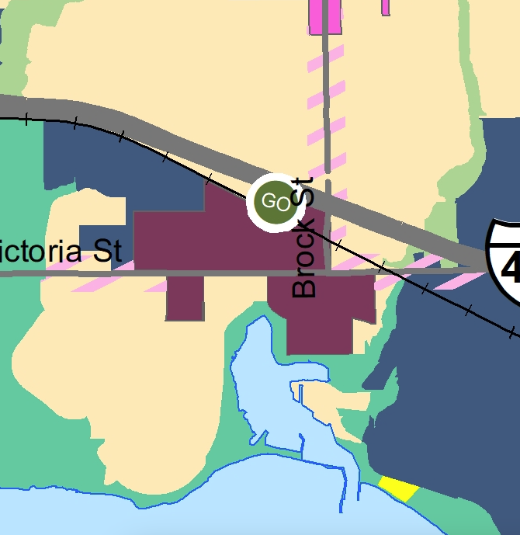
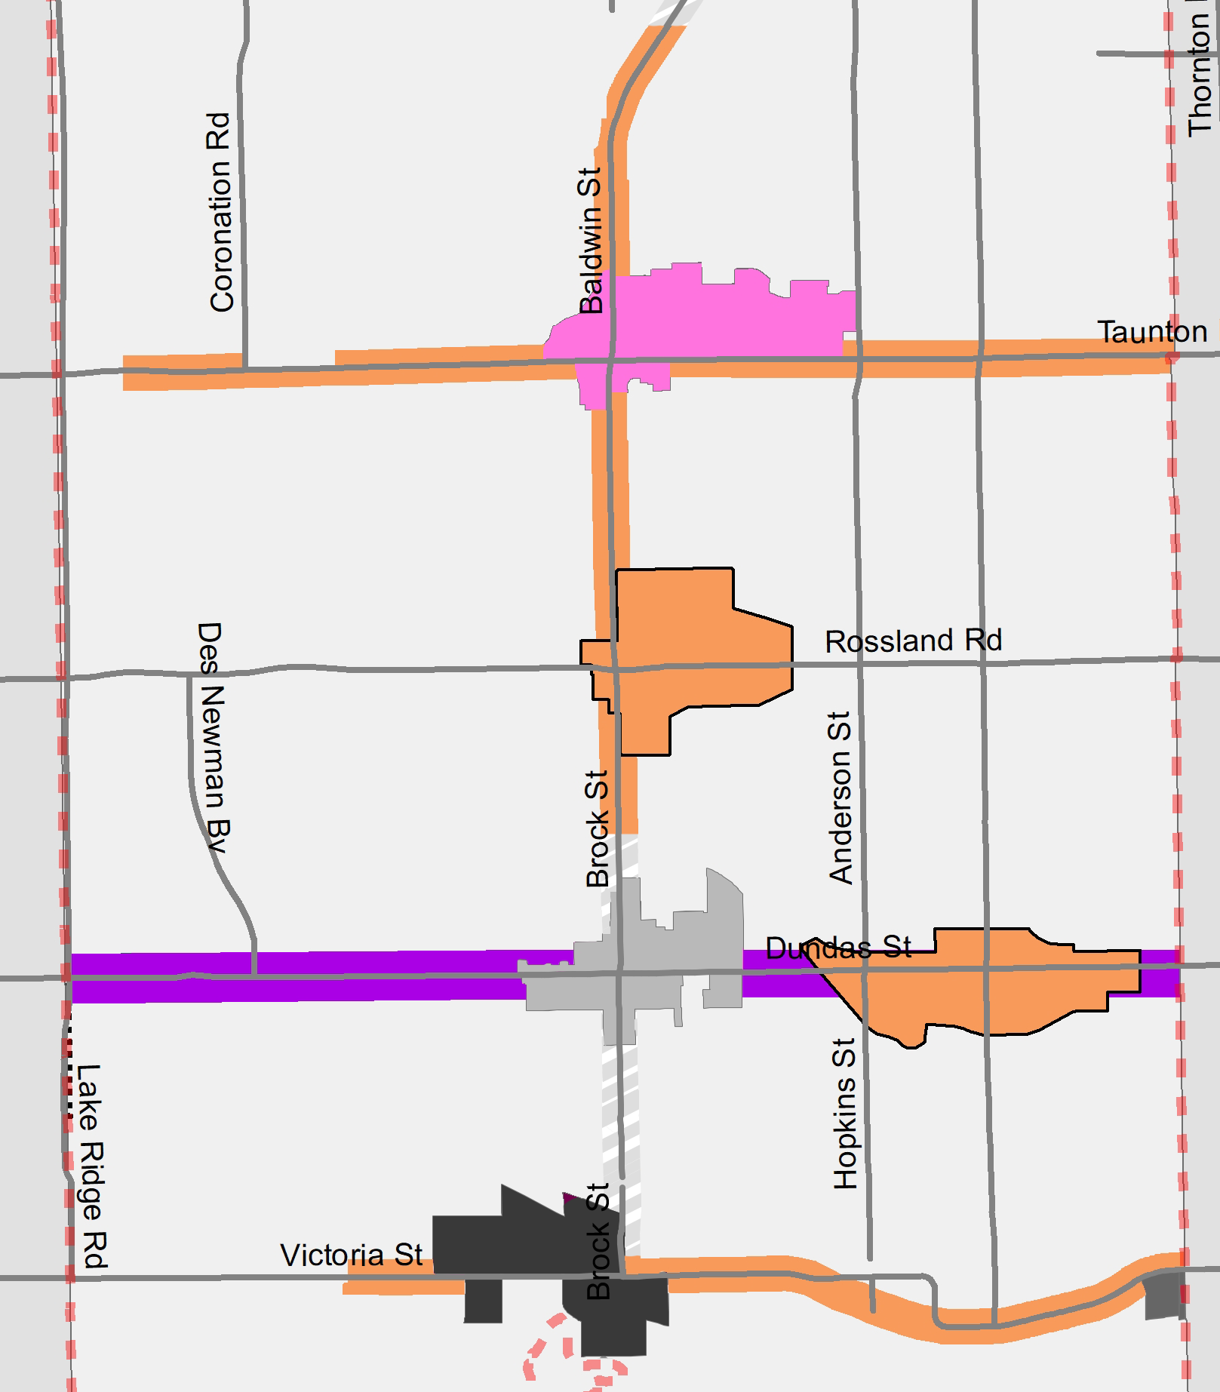
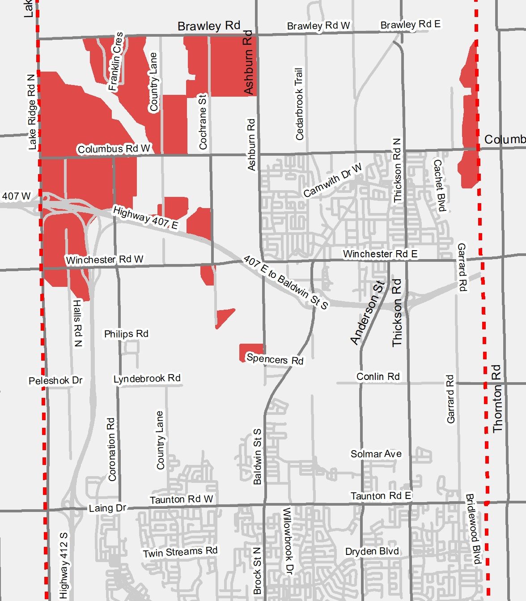








Focus Area 1
Focus Area 2
Focus Area 3
Focus Area 4
Whitby GO Protected Major Transit Station Area (PMTSA)
OPA 138
Other Strategic Growth Areas and Nodes and Corridors
OPA 139
Brooklin Urban Expansion Area per Envision Durham
OPA 148
General Updates to the Official Plan to prepare for growth to 2051
OPAs 146 & 147
PMTSA

Slide 3
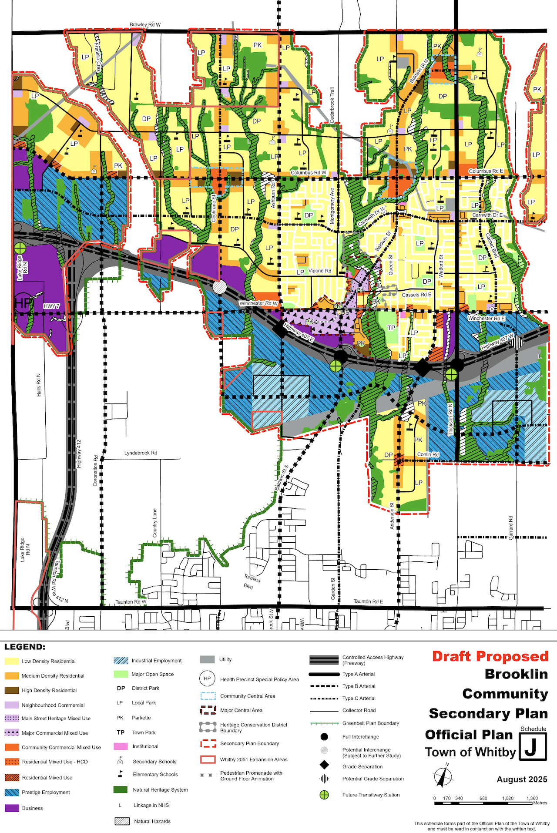
OPA 148 Key Changes – Land Use Schedule
  Introduced new designations for urban expansion area.
  Introduced 2051 Expansion Area line to reflect certain policies.
  Removed Business Park designation and changed to Prestige Employment.
  Changed Prestige Industrial designations north of Highway 407 to Business designation.

Slide 4
OPA 148 Key Changes – Land Use Schedule
  Changes to reflect new Mixed Use designations.
  Changed two Special Purpose Commercial designations to Community Commercial Mixed Use at:
    Ashburn and Winchester,
    Columbus and Thickson.

Slide 5
OPA 148 Key Changes – Policy Changes
  Health Precinct moved to west of Highway 7 and Highway 412 interchange.
  Updated policies to reflect changes in OPA 146.
  Removed Comprehensive Block Plan requirement.
  Maximum density requirements removed from the High Density and Mixed Use designations.
    controlled by height and function of built form.
  Removed minimum building height in the Major Commercial designation.

Slide 6
OPA 148 Key Changes – Policy Changes
  Requires a Hazard Lands and SWM study be prepared for the 2051 Lands:
    delineate limits of natural hazards;
    confirm limits of natural heritage system.
  Infrastructure staging and sequencing plan and fiscal impact study required for 2051 lands.
  Lake Ridge Road corridor access management study required to determine intersection control type for mid block arterial road intersection with Lake Ridge Road.
  Master Parkland Agreement to be entered into for the 2051 lands prior to first draft plan of subdivision.

Slide 7


Whitby
Official Plan Review
Questions and Comments

